Slide 1
GUI programming with Swing
Object Oriented Programming with Java
Chapter 8
FPTU Da Nang – IT Department

Slide 2
Objectives
By completion of this chapter, students should have achieved the following:
  Understand the structure and master programming skills to organize a GUI application in Java
  Understand and apply the MVC design pattern
  Know how to customize Swing components
  Understand the event handling mechanism and master the skills of writing event listener.
  Skills to self-study and use GUI components available in the library

Slide 3
Content
Introduction to MVC design pattern
Introduction to AWT & Swing
General structure of GUI interfaces
Container classes & layout manager
Basic GUI components
Event handling mechanism
Basic listener classes & customization

Slide 4
MVC (Model-View-Controller) design pattern
MVC is a software design pattern commonly used for developing user interfaces that divide the related program logic into three interconnected elements.
  Model : responsible for data processing and business logic, connecting to the database
  View: display data, interact directly with users
  Controller: common controller, MV . Binding
  Separate internal representations of information from the ways information is presented to and accepted from the user

Slide 5
MVC (Model-View-Controller) design pattern
MVC for Java GUI Application:
  Model class is independent of View
  + Java bean class
  + No console input/output
  Views are GUI interfaces
  + presentation layer
  + interact with user
  Controllers are event listeners
  + coordinate, connect view and model
  + view and listener integrated with each other

Slide 6
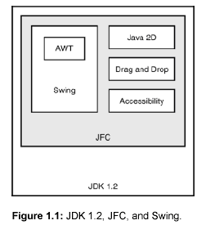
Introduction to AWT & Swing
AWT: Abstract Windows Toolkit
  The API library provides GUI objects
  Create interface link between Java application and OS
  Heavy-weight components
  Package java.awt

Slide 7
Introduction to AWT & Swing
Swing: an extension of AWT
  Create a consistent look and feel independent of the environment
  (cross-platform GUI)
  Light-weight component with many advanced features.
  pluggable look and feel
  Customizable at runtime
  Do not mix AWT and Swing GUI components on the same interface.
  Package javax.swing

Slide 8
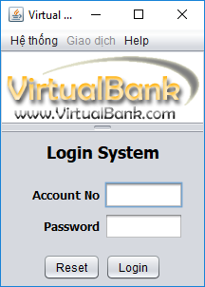
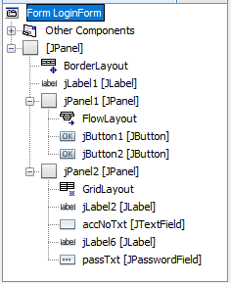
Introduction to AWT & Swing
The GUI interface is essentially the containers, with GUI controls place on it, control’s location managed by Layout Manager, interact with user controlled by Listener
Frame
Splitpane

Slide 9
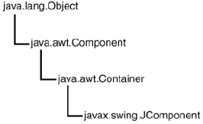
Introduction to AWT & Swing
Swing components inherit from the base class JComponent

Slide 10
Container classes
The GUI is presented on a hierarchically organized container
  Top level containers: JFrame, JDialog, JApplet
  Intermediate containers :JPanel, JScrollPane, JTabbedPane, JSplitPane..
  A GUI application is a JFrame that links multiple views (panels) through user interaction with Menus and GUI controls.
The top-level container manages intermediate containers, allowing the interface to be organized in a Z-oderring depth

Slide 11
Container classes
JFrame is a window with a title bar, location for menu bar and other controls for a standalone application.
JDialog:
  Dialog box with frame border and title, must have frame or dialog as its owner, auto display by owner
  Modal or modelless
JApplet : GUI interface for embedded web application

Slide 12
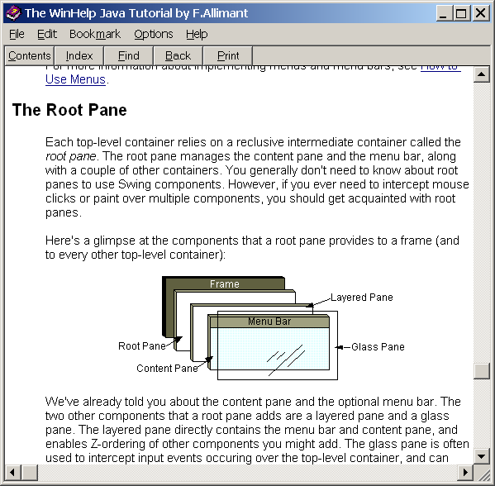
Container classes
High-level container classes:
  Managing objects mediated by rootPane and contentPane
  Use the Content Pane as a direct container for other GUI control objects.

Slide 13
Layout Manager
Each container uses a layout manager to manage the placement and size of GUI controls arranged on it.
5 commonly used layout manager classes: BorderLayout, BoxLayout, FlowLayout, GridBagLayout, and GridLayout.
Before arranging the GUI controls on the container, must pay attention to setting the appropriate layout
Each container has only 1 layout

Slide 14
Layout Manager
Default layout for container
  JFrame, JDialog, JApplet: BorderLayout
  JPanel: FlowLayout
Set up layout on container
  setLayout(LayoutManager l)
  setLayout(null): self-manage layout: absolute positioning
  Implements LayoutManager to manage layouts for custom GUI interfaces.
Container contentPane = getContentPane();
contentPane.setLayout(new FlowLayout());
  On Netbean, Free style is default layout for containers

Slide 15
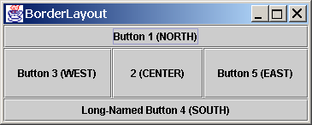
BorderLayout
Divide the container into 5 zones: BorderLayout.NORTH, BorderLayout.SOUTH, BorderLayout.EAST, BorderLayout.WEST and BorderLayout.CENTER
By default, CENTER occupies the entire area if the other 4 areas empty
When the position of control is not specified, it is entered into the CENTER
container.add(new JButton(“2 (CENTER)”)), BorderLayout.CENTER);

Slide 16
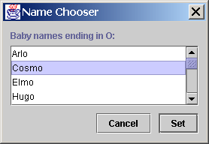
BoxLayout
Layout top to bottom|left to right
Respect the maximum size and X/Y alignment.
JPanel buttonPane = new JPanel();
buttonPane.setLayout(new BoxLayout(buttonPane, BoxLayout.X_AXIS));
buttonPane.setBorder(BorderFactory.createEmptyBorder(0, 10, 10, 10));
buttonPane.add(Box.createHorizontalGlue());
buttonPane.add(cancelButton);
buttonPane.add(Box.createRigidArea(new Dimension(10, 0)));
buttonPane.add(setButton);
Use Box.Filler(minSize, prefSize, maxSize)); to fill the space between objects

Slide 17
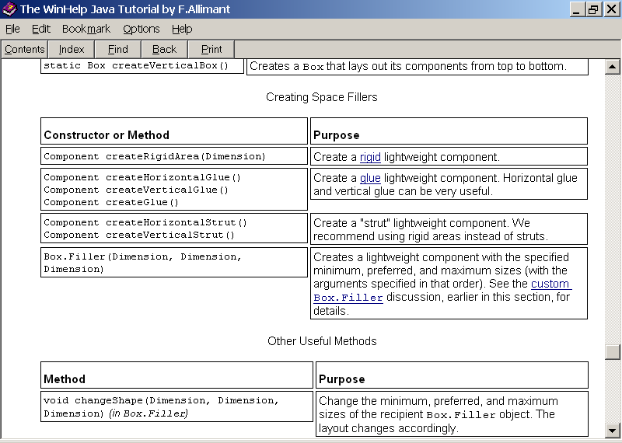
Boxlayout
BoxLayout takes care of the minimum, preferred, and maximum size requirements of components
comp.setMinimumSize(new Dimension(50, 25));
comp.setPreferredSize(new Dimension(50, 25));
comp.setMaximumSize(new Dimension(200,200));

Slide 18
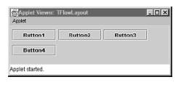
FlowLayout
Arrange the controls in rows, from left to right, from top to bottom
  FlowLayout()
  FlowLayout(int alignment)
  FlowLayout(int alignment,int horizontalGap, int verticalGap)
+ The alignment argument takes the value FlowLayout.LEFT, FlowLayout.CENTER, or FlowLayout.RIGHT.
+ horizontalGap and verticalGap indicate the pixel spacing between components.

Slide 19
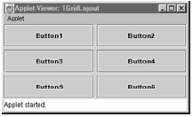
GridLayout
Organize in rows and columns evenly
public GridLayout(int rows, int columns, int horizGap, int vertGap) – must have at least columns or rows other than 0

Slide 20
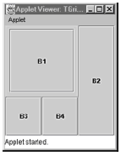
GridBagLayout
Component layout spans multiple rows and columns with different sizes
Set up a grid of cells
bind to container and layout
components above 1 or
many cells

Slide 21
LayoutManager interface
  public void layoutContainer(Container parent)
    parent is the container to be managed
    The setBounds() function is called for each component put into the parent, the position of each component should be determined by a formula relative to the size of the parent.
  Is a good layout management option with containers containing few components

Slide 22
Common GUI controls
JComponent
  JComponent is the abstract base class of all Swing components (with names starting with J – except top-container)
  Inherit from Component and Container
  Encapsulate most of the basic features and operations of a GUI component
    Setting borders and bounding
    Request focus and keystroke handling
    Aligning, scrolling, resizing behavior
    Tooltip, listener, double buffering

Slide 23
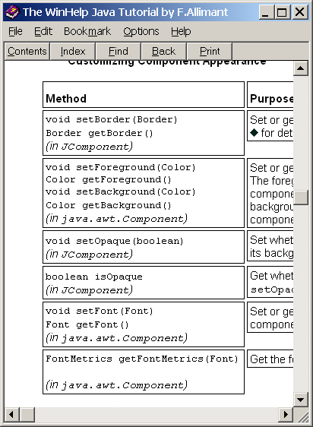
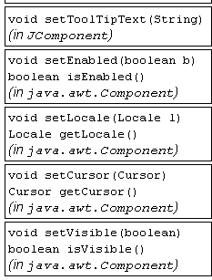
JComponent methods

Slide 24
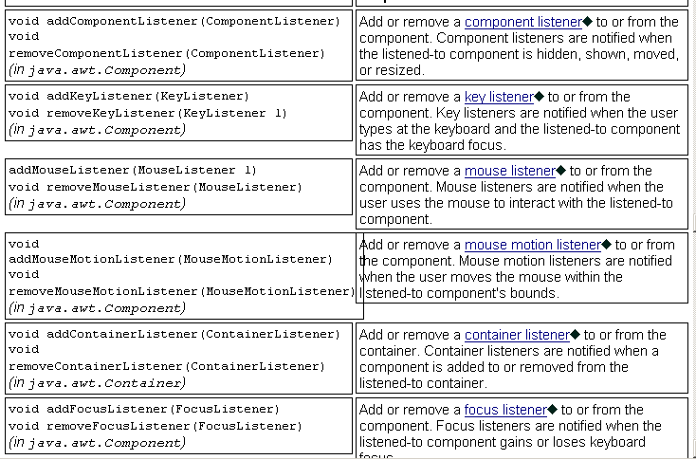
JComponent methods – event handling

Slide 25
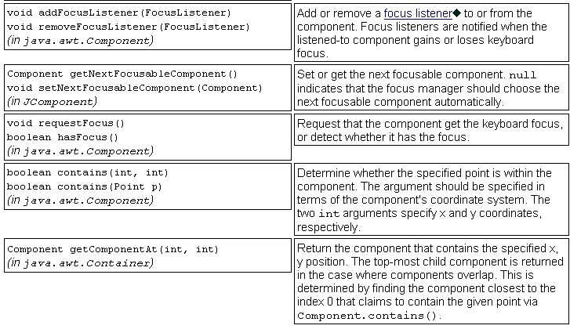
JComponent methods – event handling

Slide 26
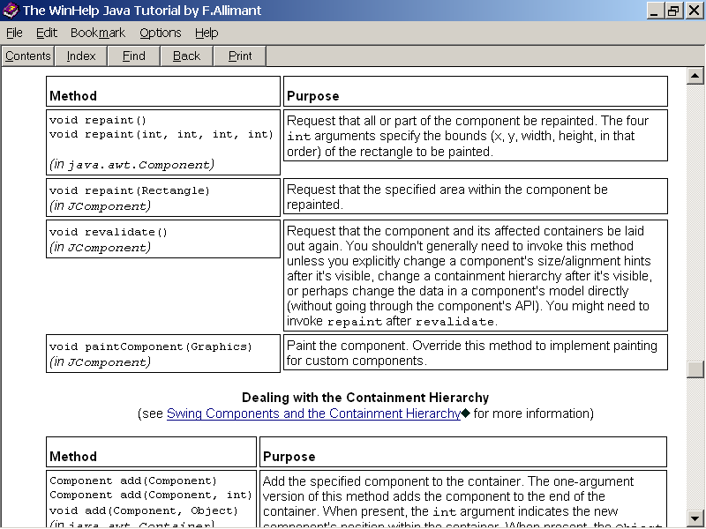
JComponent methods - painting

Slide 27
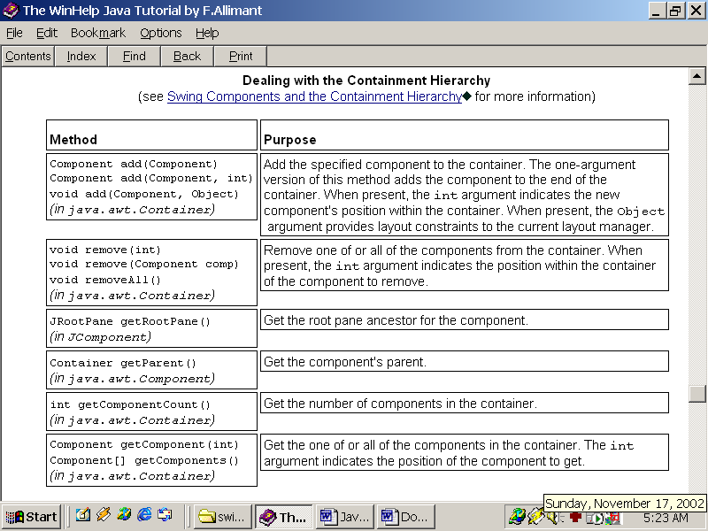
JComponent methods - Container

Slide 28
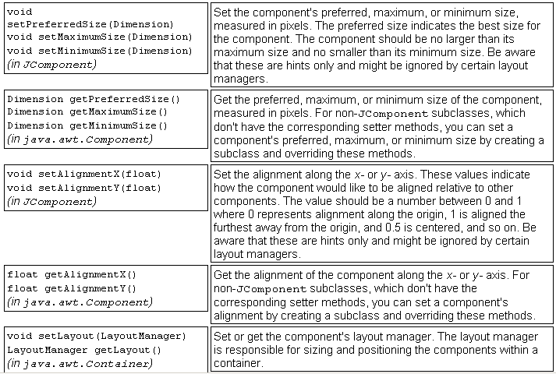
JComponent methods - Layout

Slide 29
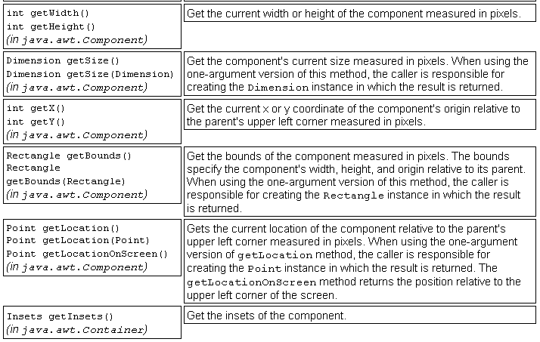
JComponent methods - Layout

Slide 30
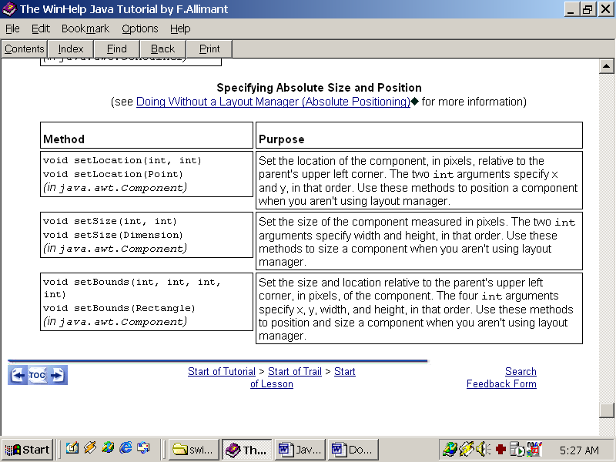
JComponent methods - Absolute Size and Position

Slide 31
Common GUI controls
JTextField: Text on 1 line
JLabel: display text or image.
JPasswordField: mask password
JTextArea: Text on multiple lines
JComboBox: select from list
JButton: command buttons with labels or logos
JCheckBox: allows multiple selection
JRadioButton: mutually exclusive selection
  Constructor, getXXX functions, Listener registration

Slide 32
Common GUI components
JTable
  TableModel is responsible for linking the table with data in rows and columns.
  DefaultTableModel(Vector<Vector> data, Vector title)
  setModel(tableModel) to set data for table
JComboBox
  The ComboBoxModel is responsible for binding the combo box to the selected data
  DefaultComboBoxModel receives data as an array or Vector<Ref_Type>, displayed in toString()
  getSelectedItem() returns the selected object

Slide 33
Handling interactive events
GUI-user interaction is represented and handled on the basis of a delegation model.
  Event: interactive event (click)
  Event source: where the event is generated (button)
  Event Listener: object authorized to handle the event.
When an event occurs, the listener - which is the object delegated to handle - will invoke a corresponding event handler method.
Allow multiple listeners to handle the same event

Slide 34
Types of events
Low level event
  Event
  AWTEvent
  KeyEvent
  MouseEvent
  WindowEvent
High level event: semantic event
  FocusEvent
  ActionEvent..
public Object getSource()
public String getActionCommand()

Slide 35
Listener classes
For each event type, the corresponding listener is registered to handle the event
JButton b= new JButton(“OK”);
b.addActionListener(new OKListener());
Listener classes are developed according to the definite interface
  ActionEvent -> ActionListener
  KeyEvent -> KeyListener
  MouseEvent -> MouseListener
  FocusEvent -> FocusListener…
Programmers write code for handler functions.

Slide 36
Listener classes
Events handle programming:
  Identify event of interest on event source
  Write the corresponding listener
  Bind listener to event source
The listener classes follow the interface defined in java.awt, should be:
  class that implements the interface or inherits the Adapter (pre-written class with empty override method body)
  class MyListener implements KeyListener {..} or
  class MyListener extends KeyAdapter {method override}
  Should be inner class or combined with container
Netbean: right click on event source, select event type, then select override method to write executable code

Slide 37
Summary
MVC design pattern
Structure and organization of GUI application interface
Using layout manager classes
Using and customizing GUI components
Event handler programming

Slide 38
References
Chapter 7 – Core Java -Vol I
Practical exercise
  Write an application that displays the text "Welcome to Swing" in the center of the window. Layout 2 buttons at the bottom of the screen, the button Increase and decrease – when the user clicks, the displayed font size increases or decreases respectively.
  Develop GUI interface for your assignment

Slide 39
Constructive questions
Why do Swing library class names start with letter J?
When developing applications according to MVC architecture, which part should be written first?
Find the solution for independent interface objects can interact with each other. For example, when clicking the Register button on the Login form, it invokes the registration form for new customers.
List solutions to assign access rights on the application depending on the user's role after logging in
Analyze the advantages and disadvantages of GUI desktop applications

Slide 40
Constructive questions
How to organize listeners for GUI applications, advantages and disadvantages of each way.
List listeners that can be installed on an application's login form. Assume reasonable constraints for listener design
Book search results are displayed on JTable. Propose a simple solution that user can interactive. For example, choose 2 books to borrow.
How to get data from database table into combobox items?
How to deploy GUI application to many distributed users, what will arise to handle?

